Slide 1

Sentimental Analysis
By A.A

Slide 2
Introduction
Many companies focused on reducing environmental impact and carbon footprints want to understand public perception of climate change. This insight would help them gauge how their eco-friendly products and services might be received, enhancing their market research efforts.
In this context, we have received a dataset sourced from Twitter, pertaining to climate change.
Problem Statement: Building a deep learning model to classify whether people believe in climate change based on their tweets, in order to improve and tailor customer-based products.
Each tweet is labelled as one of the following classes:
2: News(the tweet links to factual news about climate change)
1: Believer(the tweet supports the belief of man-made climate change)
0: Neutral(the tweet neither supports nor refutes the belief of man-made climate change)
-1: Agnostic(the tweet does not believe in man-made climate change)

Slide 3
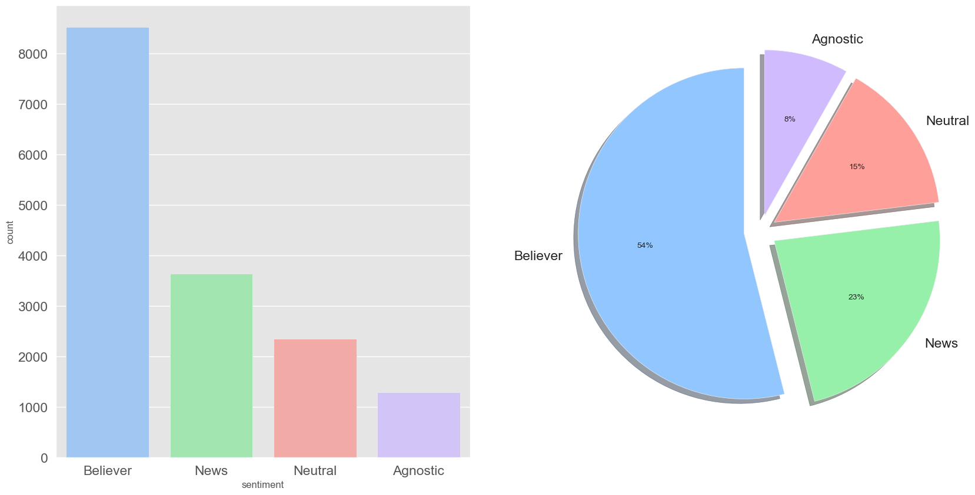
Distribution of Sentiment

Slide 4
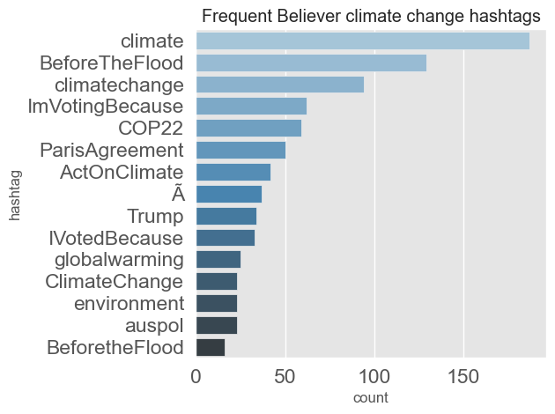
Frequent Believer Climate Change Hashtags

Slide 5
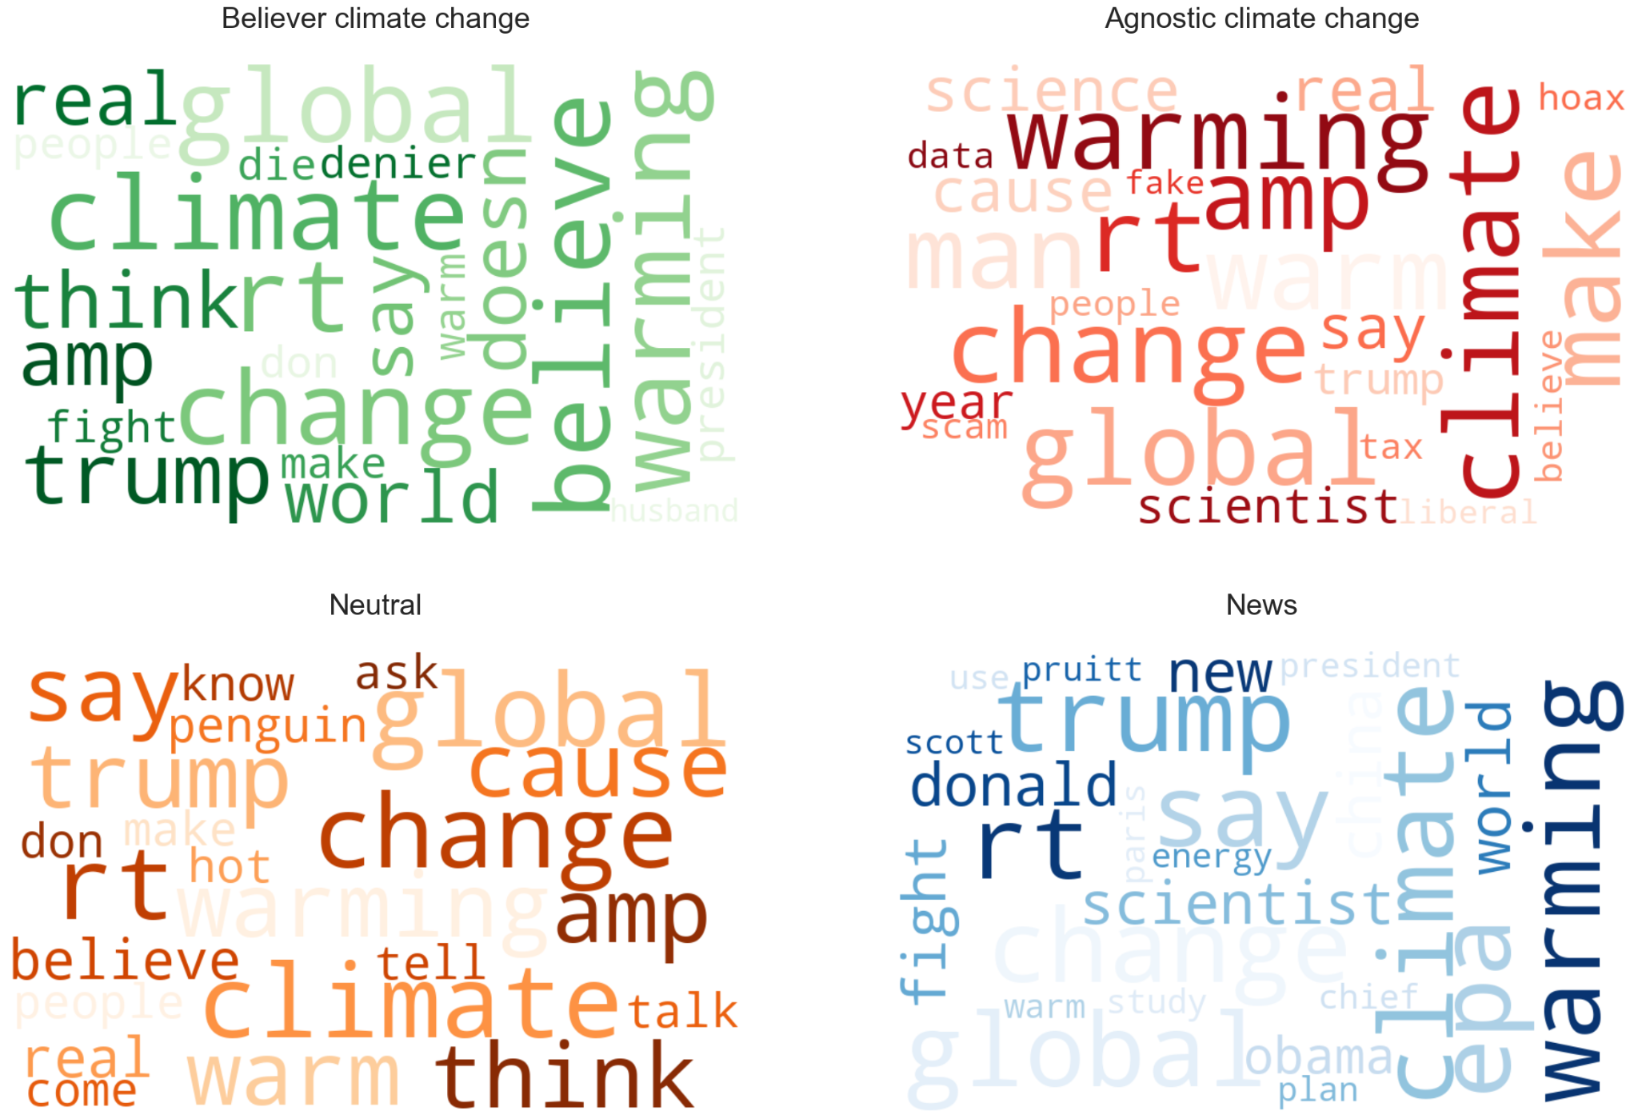
Word Count for Sentiments

Slide 6
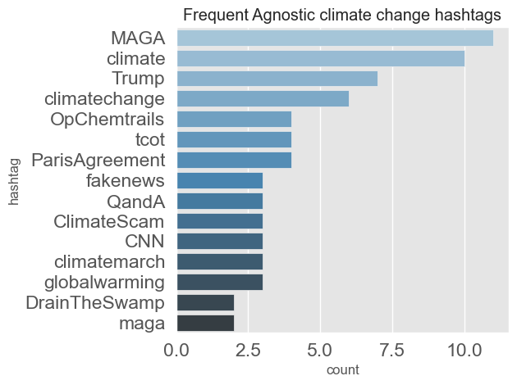
Frequent Agnostic Climate Change Hashtags

Slide 7
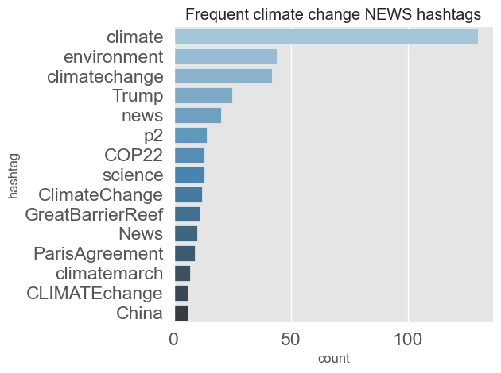
Frequent Climate Change News Hashtags

Slide 8
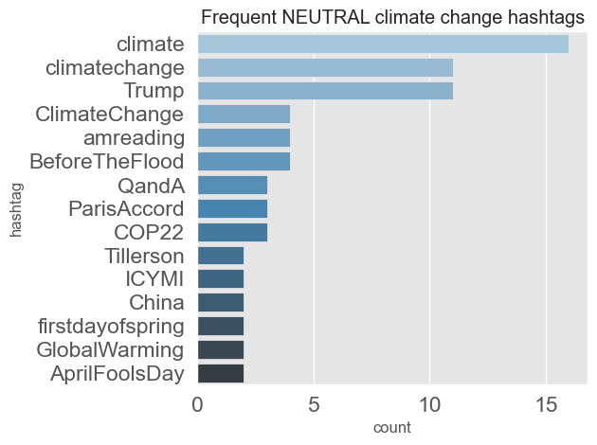
Frequent Neutral Climate Change Hashtags

